Slide 1
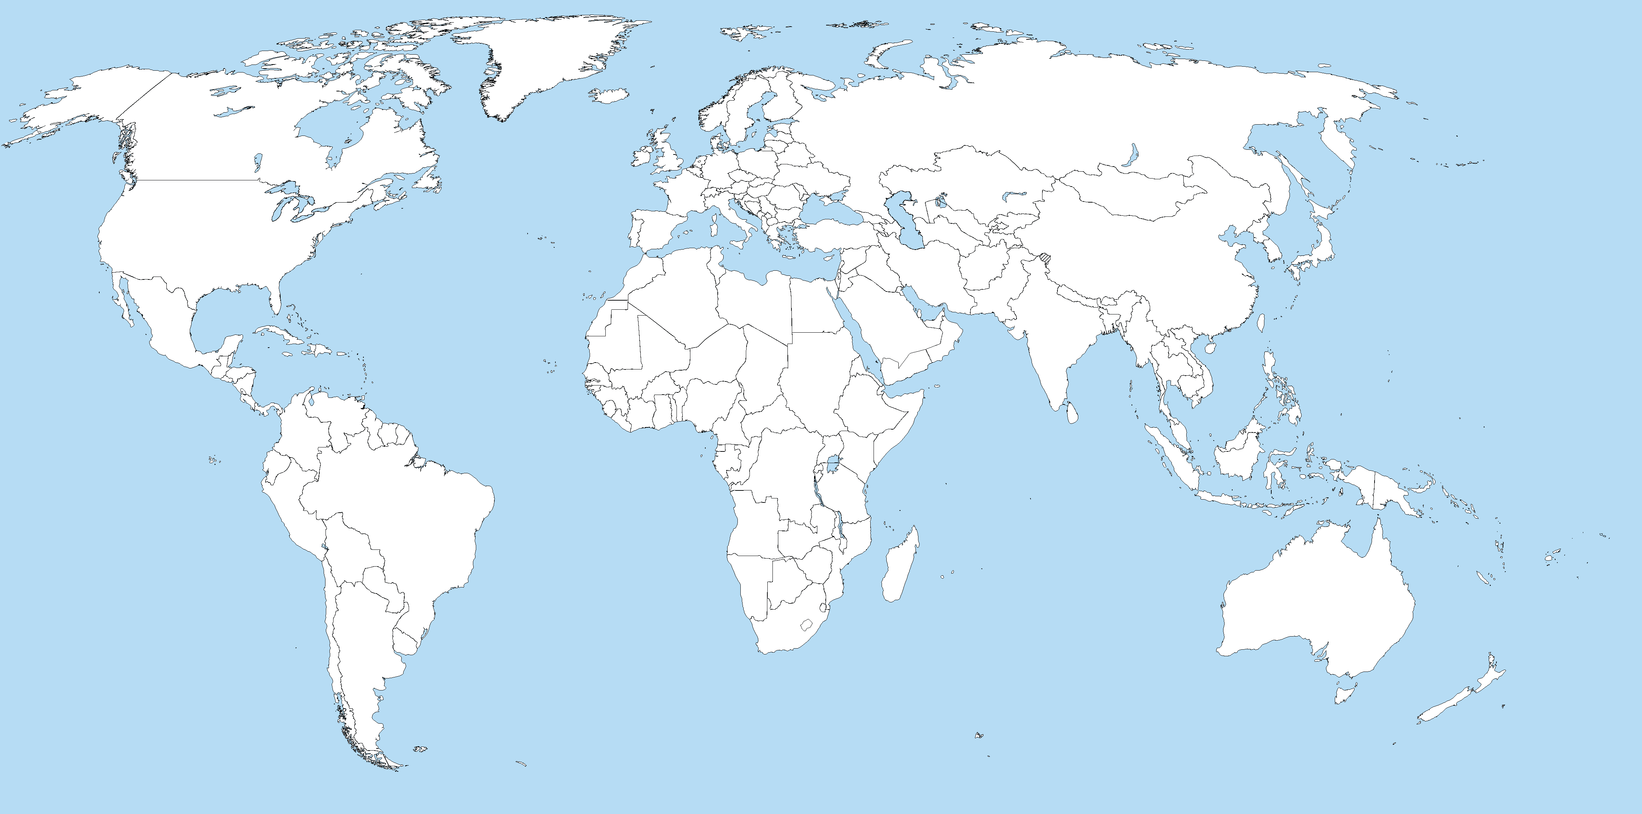

Slide 2
How was this Resource obtained?
How did mining or growing this resource impact the Environment?
What jobs did the need for this resource create?
How was this resource moved to where it was needed?
What jobs were needed to move the resource?

Slide 3
How does the product get from the factory to the market?
How does this movement impact the environment?
What jobs were needed to produce and market this product?

Slide 4
Essay
Explain why people in different countries have to depend on each other.
(3-5 Quality Sentences)

